Slide 1
Advanced SQL
Prof. X

Slide 2
Outline
Join Expressions
Recursive SQL
Integrity Constraints
SQL Data Types and Schemas
Index Definition in SQL
Authorization

Slide 3
Joined Relations
Join operations take two relations and return as a result another relation.
A join operation is a Cartesian product which requires that tuples in the two relations match (under some condition). It also specifies the attributes that are present in the result of the join
The join operations are typically used as subquery expressions in the from clause
Three types of joins:
Natural join
Inner join
Outer join

Slide 4
Natural Join in SQL
Natural join matches tuples with the same values for all common attributes, and retains only one copy of each common column.
List the names of instructors along with the course ID of the courses that they taught
select name, course_id from instructor, takes where instructor.ID = takes.ID;
Same query in SQL with “natural join” construct
select name, course_id from instructor natural join takes;

Slide 5
Natural Join in SQL (Cont.)
The from clause can have multiple relations combined using natural join:
select A₁, A₂, … A_{n} from r₁ natural join r₂ natural join .. natural join r_{n} where P ;

Slide 6
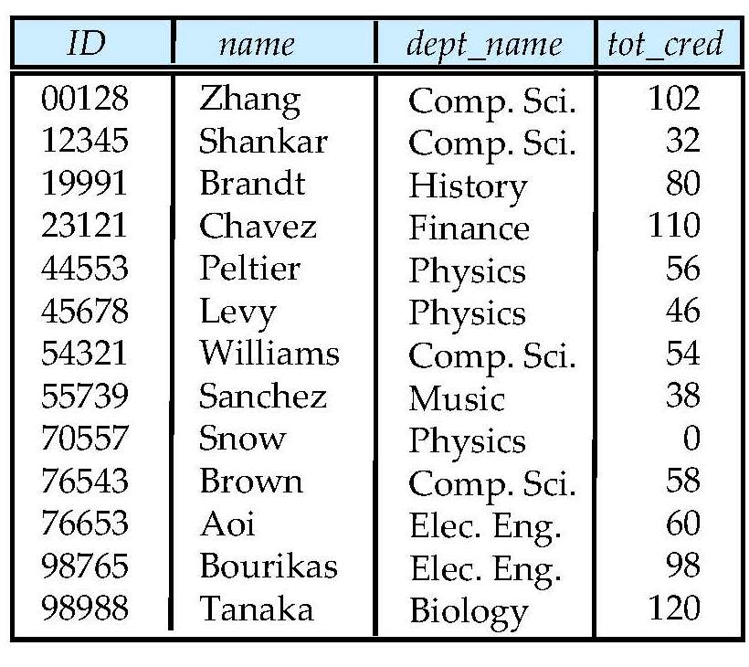
Student Relation

Slide 7
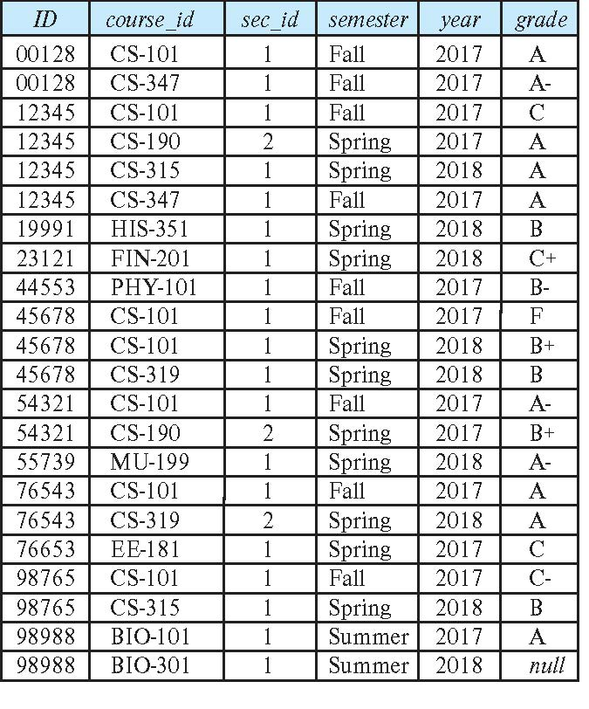
Takes Relation

Slide 8
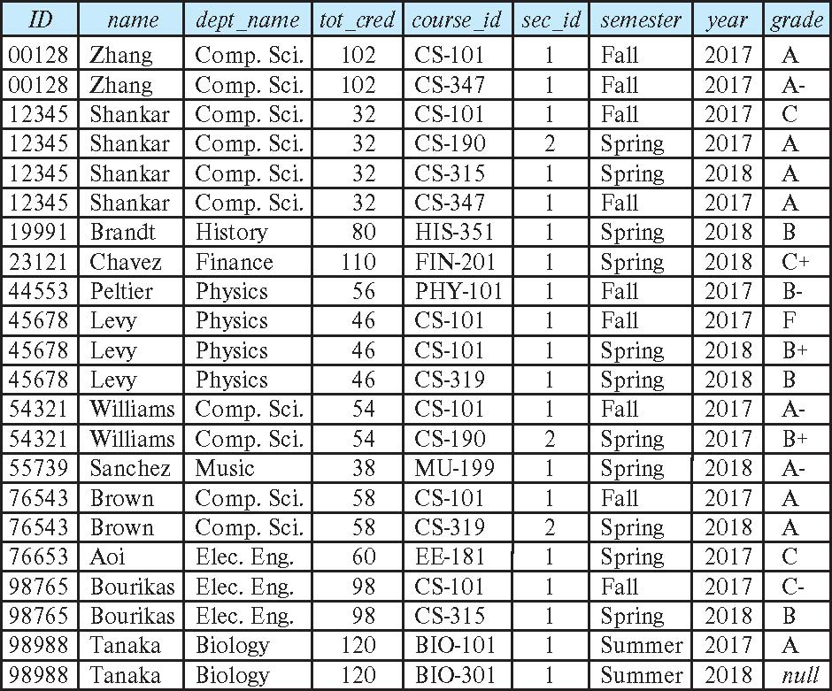
student natural join takes

Slide 9
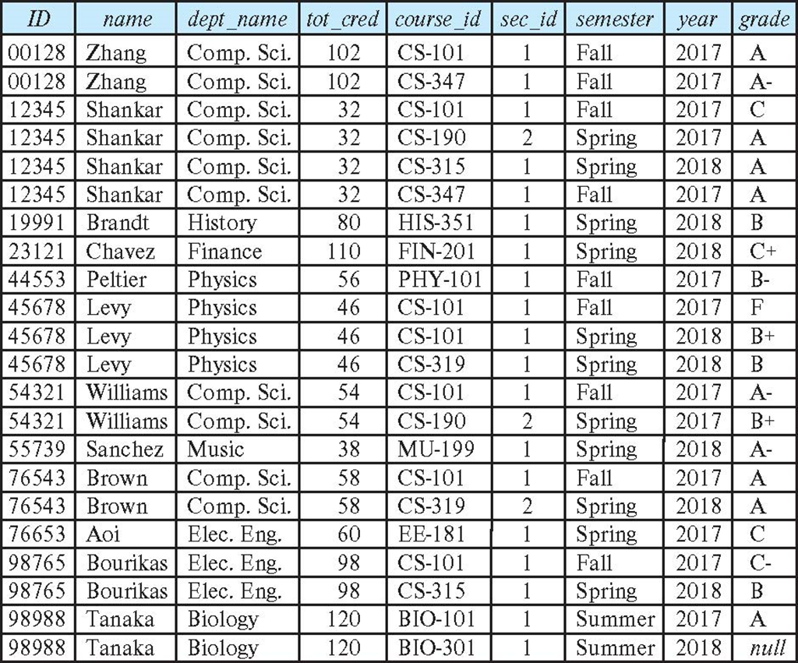
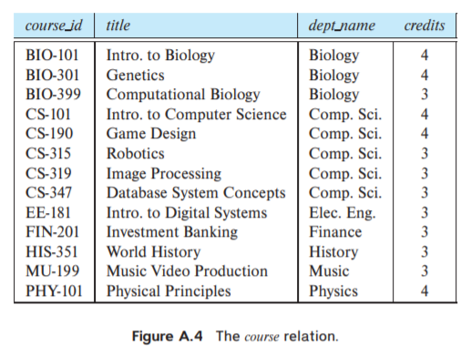
Dangerous in Natural Join
Beware of unrelated attributes with same name which get equated incorrectly
Example -- List the names of students along with the titles of courses that they have taken
Correct version
select name, title from student natural join takes, course where takes.course_id = course.course_id;
Incorrect version
select name, title from student natural join takes natural join course;
The incorrect version is equivalent to
Select name, title
From student natural join takes, course
Where takes.course_id = course.course_id AND student.dept_name = course.depart_name;
This query omits all (student name, course title) pairs where the student takes a course in a department other than the student's own department.
The correct version (above), correctly outputs such pairs.

Slide 10
Join with Using Clause
To avoid the danger of equating attributes erroneously, we can use the “using” construct that allows us to specify exactly which columns should be equated.
Query example
select name, title from (student natural join takes) join course using (course_id)

Slide 11
Join Condition
The on condition allows a general predicate (returns true or false) over the relations being joined
This predicate is written like a where clause predicate except for the use of the keyword on
Query example
select * from student join takes on student_ID = takes_ID
The on condition above specifies that a tuple from student matches a tuple from takes if their ID values are equal.
Difference between on and using: after using: we have an attribute, not a predicate
Equivalent to:
select * from student , takes where student_ID = takes_ID

Slide 12
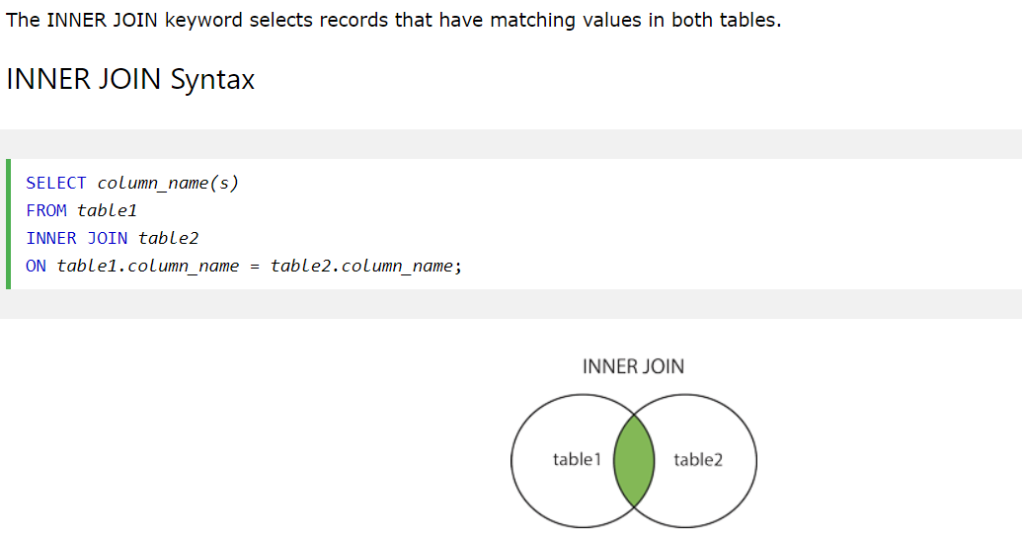
Inner Join https://www.geeksforgeeks.org/difference-between-natural-join-and-inner-join-in-sql/

Slide 13
Outer Join
An extension of the join operation that avoids loss of information.
Computes the join and then adds tuples form one relation that does not match tuples in the other relation to the result of the join.
Uses null values.
Three forms of outer join:
left outer join
right outer join
full outer join

Slide 14
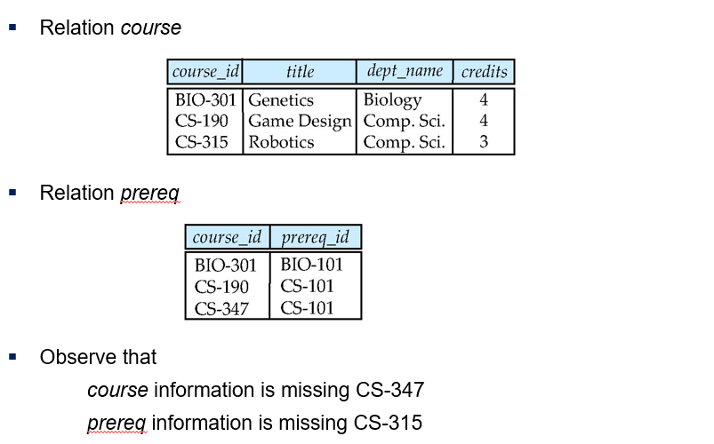
Outer Join Examples

Slide 15
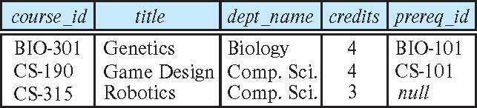
Left Outer Join
course natural left outer join prereq

Slide 16
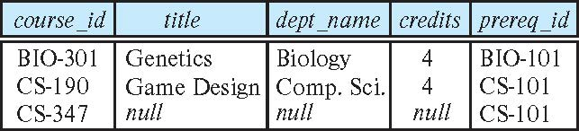
Right Outer Join
course natural right outer join prereq

Slide 17
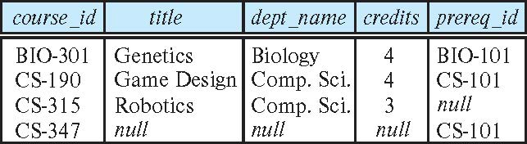
Full Outer Join
course natural full outer join prereq

Slide 18
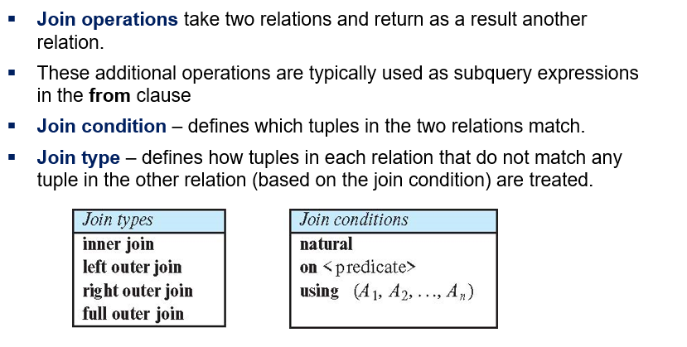
Joined Types and Conditions

Slide 19

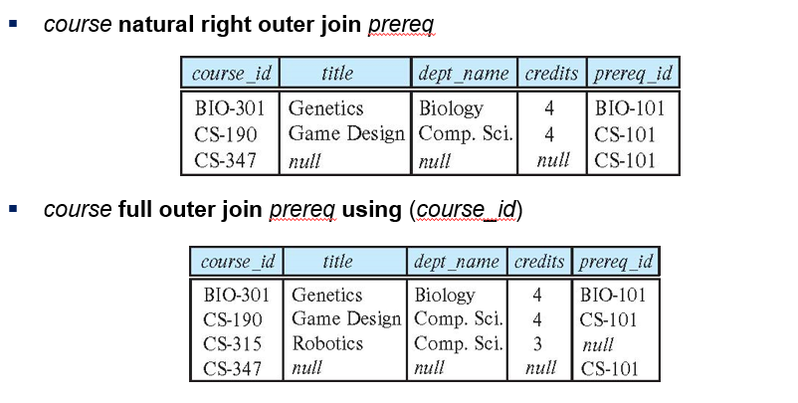
Joined Relations – Examples

Slide 20

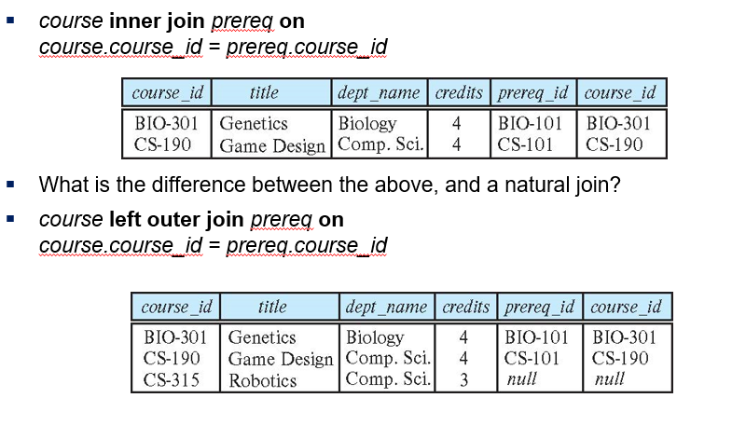
Joined Relations – Examples

Slide 21
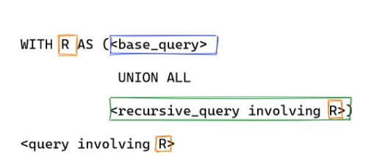
Recursive SQL
It’s common to store hierarchical data in SQL and recursive queries are a convenient way to extract information from such graphs.
E.g., find all supervisor of Bob (direct and indirect)
Recursion in SQL is achieved by with statement
In SQL, it is called Common Table Expression (CTE) \
Usually, recursive with statement has the following form:

Slide 22
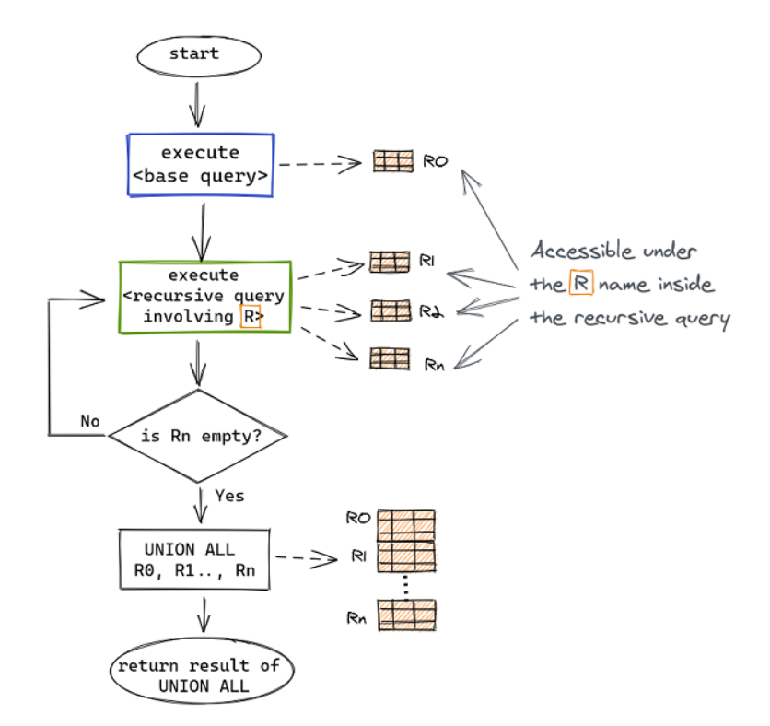
Recursive SQL (cont.)

Slide 23
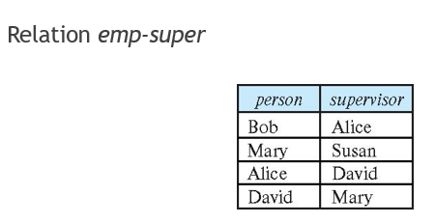
Recursive SQL (cont.)
with countUp as (select 1 as n
union all
select n+1 from countUp where n < 3)
select * from countUp;
with allSuper as (select supervisor as s from emp_super where person = ‘Bob’
union all
select supervisor from allSuper, emp_super
where allSuper.s = emp_super.person)
select * from allSuper;

Slide 24
Integrity Constraints
Integrity constraints guard against accidental damage to the database, by ensuring that authorized changes to the database do not result in a loss of data consistency.
A checking account must have a balance greater than $10,000.00
A salary of a bank employee must be at least $4.00 an hour
A customer must have a (non-null) phone number

Slide 25
Constraints on a Single Relation
not null
primary key
unique
check (P), where P is a predicate; P returns true or false.

Slide 26
Not Null Constraints
not null
Declare name and budget to be not null
name varchar(20) not null budget numeric(12,2) not null

Slide 27
Unique Constraints
unique ( A₁, A₂, …, A_{m})
The unique specification states that the attributes A₁, A₂, …, A_{m} form a candidate key.
Candidate keys are permitted to be null (in contrast to primary keys).

Slide 28
The check clause
The check (P) clause specifies a predicate P that must be satisfied by every tuple in a relation.
Example: ensure that semester is one of fall, winter, spring or summer
create table section
(course_id varchar (8),
sec_id varchar (8),
semester varchar (6),
year numeric (4,0),
building varchar (15),
room_number varchar (7),
time slot id varchar (4),
primary key (course_id, sec_id, semester, year),
check (semester in ('Fall', 'Winter', 'Spring', 'Summer')))

Slide 29
Complex Check Conditions
The predicate in the check clause can be an arbitrary predicate that can include a subquery.
check (time_slot_id in (select time_slot_id from time_slot))
The check condition states that the time_slot_id in each tuple in the section relation is actually the identifier of a time slot in the time_slot relation.
The condition has to be checked not only when a tuple is inserted or modified in section , but also when the relation time_slot changes

Slide 30
Referential Integrity
Ensures that a value that appears in one relation for a given set of attributes also appears for a certain set of attributes in another relation.
Example: If “Biology” is a department name appearing in one of the tuples in the instructor relation, then there exists a tuple in the department relation for “Biology”.
Let A be a set of attributes. Let R and S be two relations that contain attributes A and where A is the primary key of S. A is said to be a foreign key of R if for any values of A appearing in R these values also appear in S.

Slide 31
Referential Integrity (Cont.)
Foreign keys can be specified as part of the SQL create table statement
foreign key (dept_name) references department
By default, a foreign key references the primary-key attributes of the referenced table.
SQL allows a list of attributes of the referenced relation to be specified explicitly.
foreign key (dept_name) references department (dept_name)

Slide 32
Assertions
An assertion is a predicate expressing a condition that we wish the database always to satisfy.
The following constraints, can be expressed using assertions:
For each tuple in the student relation, the value of the attribute tot_cred must equal the sum of credits of courses that the student has completed successfully.
An instructor cannot teach in two different classrooms in a semester in the same time slot
An assertion in SQL takes the form:
create assertion <assertion-name> check (<predicate>);
create assertion credit_assertion check (tot_cred = (select sum(credits) from … where…));

Slide 33
User-Defined Types
create type construct in SQL creates user-defined type
create type Dollars as numeric (12,2) final
Example:
create table department (dept_name varchar (20), building varchar (15), budget Dollars);

Slide 34
Domains
create domain construct in SQL-92 creates user-defined domain types
create domain person_name char(20) not null
Types and domains are similar. Domains can have constraints, such as not null, specified on them.
Example:
create domain degree_level varchar(10) constraint degree_level_test check (value in ('Bachelors', 'Masters', 'Doctorate'));

Slide 35
Index Creation
Many queries reference only a small proportion of the records in a table.
It is inefficient for the system to read every record to find a record with particular value
An index on an attribute of a relation is a data structure that allows the database system to find those tuples in the relation that have a specified value for that attribute efficiently, without scanning through all the tuples of the relation.
We create an index with the create index command
create index <name> on <relation-name> (attribute);

Slide 36
Index Creation Example
create table student (ID varchar (5), name varchar (20) not null, dept_name varchar (20), tot_cred numeric (3,0) default 0, primary key (ID))
create index studentID_index on student(ID)
The query:
select * from student where ID = '12345'
can be executed by using the index to find the required record, without looking at all records of student

Slide 37
Authorization Specification in SQL
The grant statement is used to confer authorization
grant <privilege list> on <relation or view > to <user list>
<user list> is:
a user-id
public, which allows all valid users the privilege granted
A role (more on this later)
Example:
grant select on department to Amit, Satoshi
Granting a privilege on a view does not imply granting any privileges on the underlying relations.
The grantor of the privilege must already hold the privilege on the specified item (or be the database administrator).

Slide 38
Privileges in SQL
select: allows read access to relation, or the ability to query using the view
Example: grant users U₁, U₂, and U₃ select authorization on the instructor relation:
grant select on instructor to U₁, U₂, U₃
insert: the ability to insert tuples
update: the ability to update using the SQL update statement
delete: the ability to delete tuples.
all privileges: used as a short form for all the allowable privileges

Slide 39
Revoking Authorization in SQL
The revoke statement is used to revoke authorization.
revoke <privilege list> on <relation or view> from <user list>
Example:
revoke select on student from U₁, U₂, U₃
<privilege-list> may be all to revoke all privileges the revokee may hold.
If <revokee-list> includes public, all users lose the privilege except those granted it explicitly.
If the same privilege was granted twice to the same user by different grantees, the user may retain the privilege after the revocation.
All privileges that depend on the privilege being revoked are also revoked.

Slide 40
Roles
A role is a way to distinguish among various users as far as what these users can access/update in the database.
To create a role we use:
create role <name>
Example:
create role instructor
Once a role is created we can assign “users” to the role using:
grant <role> to <users>

Slide 41
Roles Example
create role instructor;
grant instructor to Amit;
Privileges can be granted to roles:
grant select on takes to instructor;
Roles can be granted to users, as well as to other roles
create role teaching_assistant
grant teaching_assistant to instructor;
Instructor inherits all privileges of teaching_assistant
Chain of roles
create role dean;
grant instructor to dean;
grant dean to Satoshi;

